Slide 1
Unit 1
Chapter 2
Incepting Enterprise Applications
T.Kumaravel
AP/CSE

Slide 2
Introduction to Inception
Incepting an enterprise application is the first life cycle phase of raising enterprise applications that primarily consists of the following activities:
Enterprise analysis
Business modeling
Requirements elicitation & analysis
Requirements validation
Planning and estimation

Slide 3
1. Enterprise Analysis
Enterprise analysis is typically done by business analysts, and comprise of following key activities:
Identification of business opportunities and business changes.
Identification of various stakeholders across business units.
Collection of business requirements and prioritizing them.
Define business roadmap with scope and exclusions.
Determines the high level investment needed for the enterprise
Conduct feasibility study for any changes proposed
Conduct risk analysis and competitive analysis.
Decides on build-or-buy strategy
Create RoI (Return on Investment) business cases with proper justification
Get the necessary approvals from the sponsors.

Slide 4
2. Business Modeling
Business modeling helps one to understand the business information and the business processes which an enterprise uses to fulfill its business goals.
Enterprise analysis could lead to two forms of programs/projects:
  1. Creating something new. Also called as development project
  2. Extension/change to something which already exists. Also called as re-engineering project
Business modeling is done by business analysts
To understand the business process construct the following models,
1. As-is model
2. To-be model

Slide 5
2. Business Modeling (contd..)
1. As-is model
As-is model reflects the existing business process
2. To-be model
  To-be model reflects the desired business process that is how the business model to be in the future is represented in the To-be model

Slide 6
2. Business Modeling (contd..)
Example: (As-is model and To-be model)
Easy Money Bank(EM Bank)
To keep up with the market competition, the bank’s management has decided to expand the loan offerings and to reach out to more number of customers (both existing and new).
Business Analyst has performed the task of business modeling and has come out with the AS-IS and TO-BE processes depicted in the two diagrams shown in next two slides

Slide 7
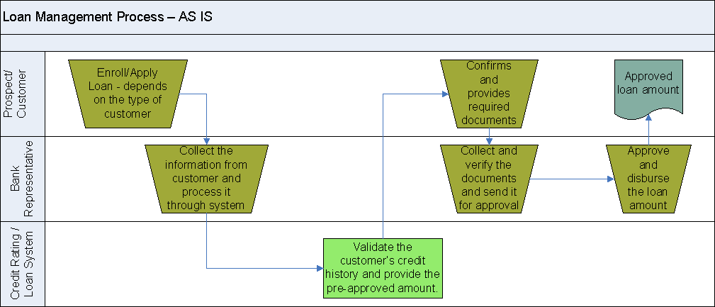
2. Business Modeling (contd..)
Above diagram shows the AS IS model of the Loan Management Process where loan is provided only in offline. This is the current model of Loan Management process

Slide 8
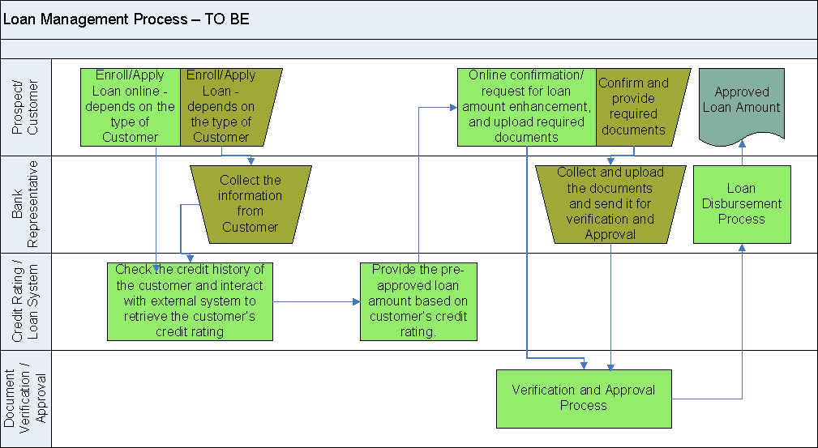
2. Business Modeling (contd..)
Text.
Text.
Above diagram shows the TO BE model of the Loan Management Process where loan is planned to be provided in both offline and online. Based on that some features has been added in the current model

Slide 9
3. Requirement Elicitation and Analysis
Requirements elicitation and analysis is an approach of capturing client requirements, analyzing them and documenting the problem domain.
Requirement Elicitation and Analysis phases involves the collection of Functional and Nonfunctional requirements
Requirements divided into two categories:
  1. Functional Requirements:
  They are basically the requirements stated by the user which one can see directly in the final product
  Functional requirements capture what the system is expected to do.
  To depict functional requirements “use cases” and prototypes are used
  Example:
  Authentication of user whenever he/she logs into the system.
  A Verification email is sent to user whenever he/she registers for the first time on some software system.

Slide 10
3. Requirement Elicitation and Analysis (contd..)
  Non Functional Requirements(NFR):
  A non-functional requirement defines the quality of a software system
  NFRs capture how the system does what it is expected to do with respect to its constraints and expected qualities of service (QoS) such as reliability, scalability, portability, usability, availability, security and performance.
  Example:
  The site should load in 3 seconds
  The processing of each request should be done within 10 seconds
  Emails should be sent with a latency of no greater than 12 hours

Slide 11
3. Requirement Elicitation and Analysis (contd..)
Functional vs Non-Functional Requirements
Functional Requirements | Non-Functional Requirements
Functional requirements capture what the system is expected to do. | Non-Functional Requirements capture how the system does what it is expected to do
Functional requirement is specified by User. | Non-functional requirement is specified by technical peoples e.g. Architect, Technical leaders and software developers.
Helps you verify the functionality of the software. | Helps you to verify the performance of the software.
It is mandatory. | It is not mandatory.
It concentrates on the user's requirement. | It concentrates on the expectation and experience of the user.
Example | Example

Slide 12
3. Requirement Elicitation and Analysis (contd..)
Functional Requirements are represented with the help of use case diagrams
Actors ,Use Cases and Relationship
Actors (or) entities:
Actors or entities are the one who use the system.
Actors may a human user (or) system user
Use cases:
Functional reasons why actors use the system are called as Uses cases
Use cases are initiated by the actors.
Ellipses represent use cases
Relationship:
After identification of actors and use cases relationship between them has to be identified
Simple relationship that exists between actors and use cases is Association relationship
Association relationship is represented with straight line between actor and use case

Slide 13
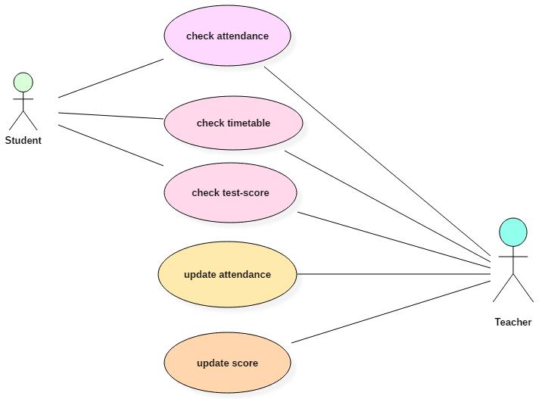
3. Requirement Elicitation and Analysis (contd..)
Example of Use Case Diagram
Use case diagrams can be drawn with the help of software's like Rational Software Architect, Vision and Together Architect, AgroUML
Actors:
Student, Teacher
Use cases:
Check attendance, check timetable, check test-score, update attendance, update score
Relationship:
Represented as line from actor to use cases

Slide 14
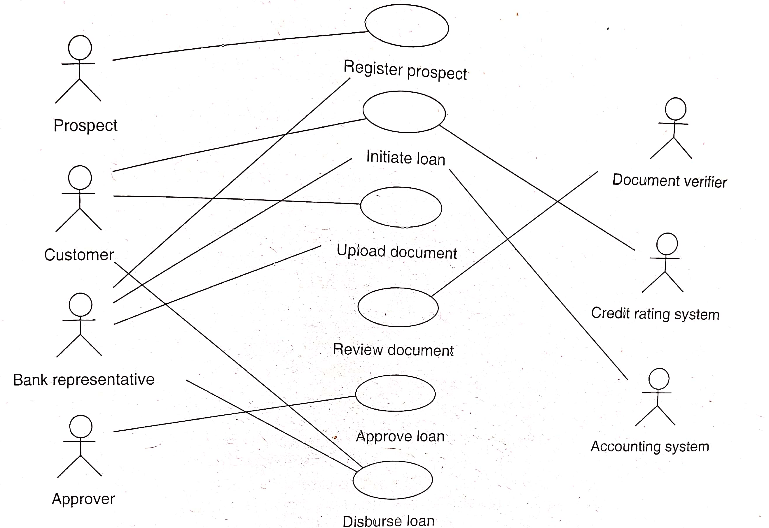
3. Requirement Elicitation and Analysis (contd..)
Example of Use Case Diagram

Slide 15
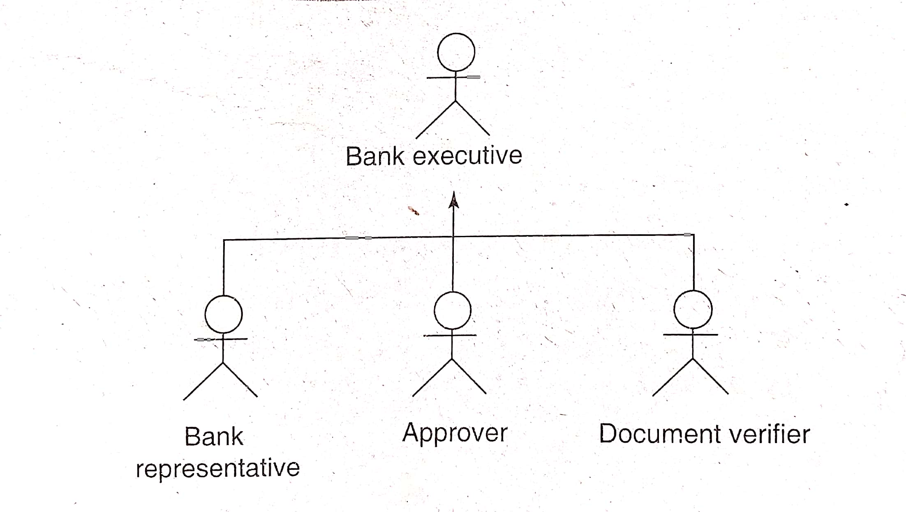
3. Requirement Elicitation and Analysis (contd..)
Relationship among actors
The only relationship that exists among the actors is Generalization relationship
Bank executive actor generalizes the bank representative, approver and document verifier

Slide 16
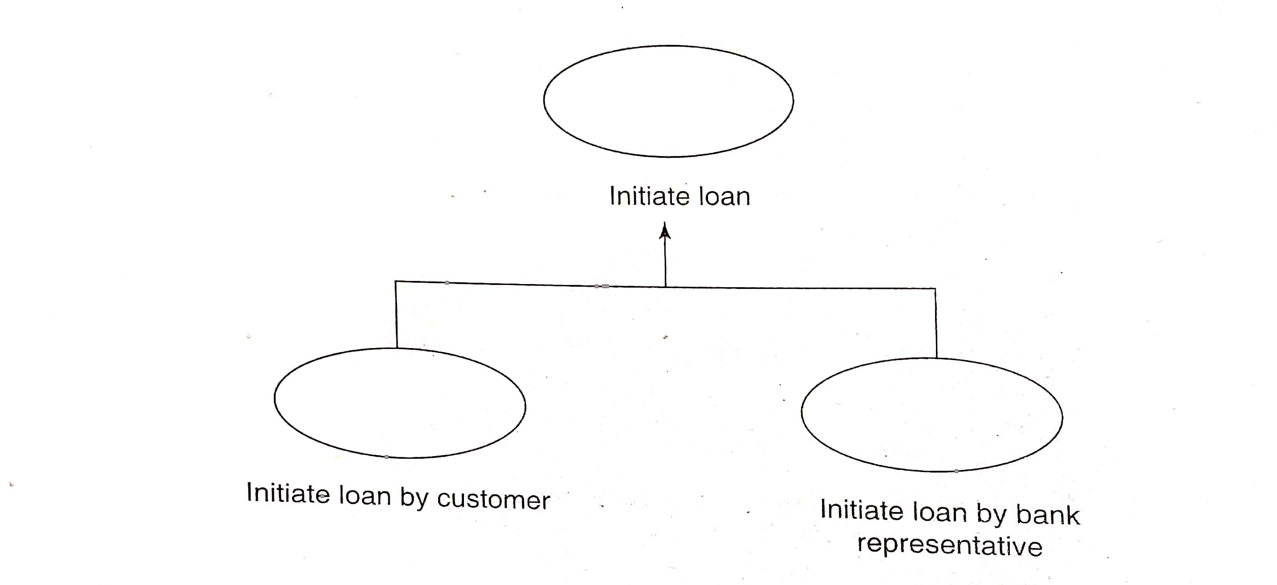
3. Requirement Elicitation and Analysis (contd..)
Relationship among use cases
Generalization relationship
If a particular use case generalizes some use cases (or) if a particular use case is a specialized form of another use case then it is termed as Generalization relationship
Initiate loan by customer and Initiate loan by Bank Representative are the specialized use cases of Initiate Loan

Slide 17
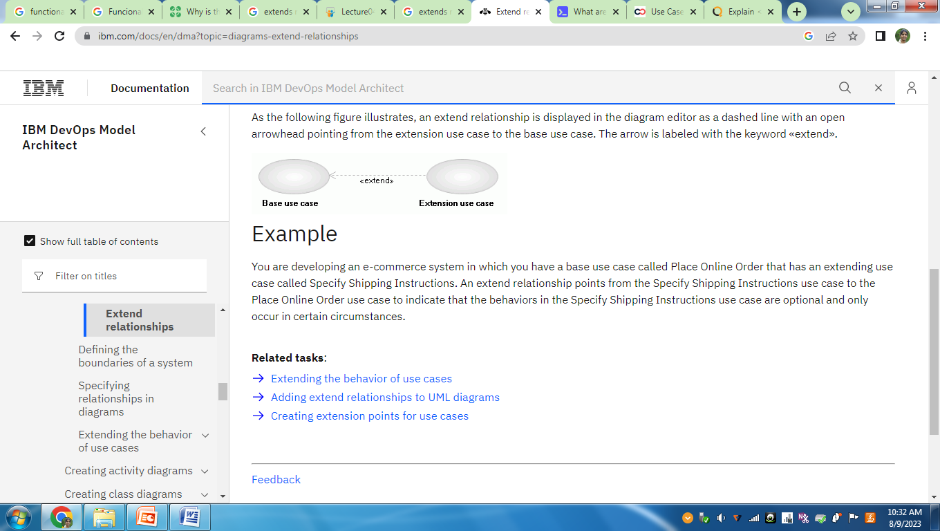
3. Requirement Elicitation and Analysis (contd..)
Relationship among use cases
2. Extends relationship
An extend relationship is used to specify that one use case (extension) extends the behavior of another use case (base or extended)
The extension use case is dependent on the base use case. But base use case is independent of extension use case
When base use case is executed not all the time extension use case is executed.
This relationship is represented by dashed arrow from extension use case towards base use case with notation <<extend>>

Slide 18
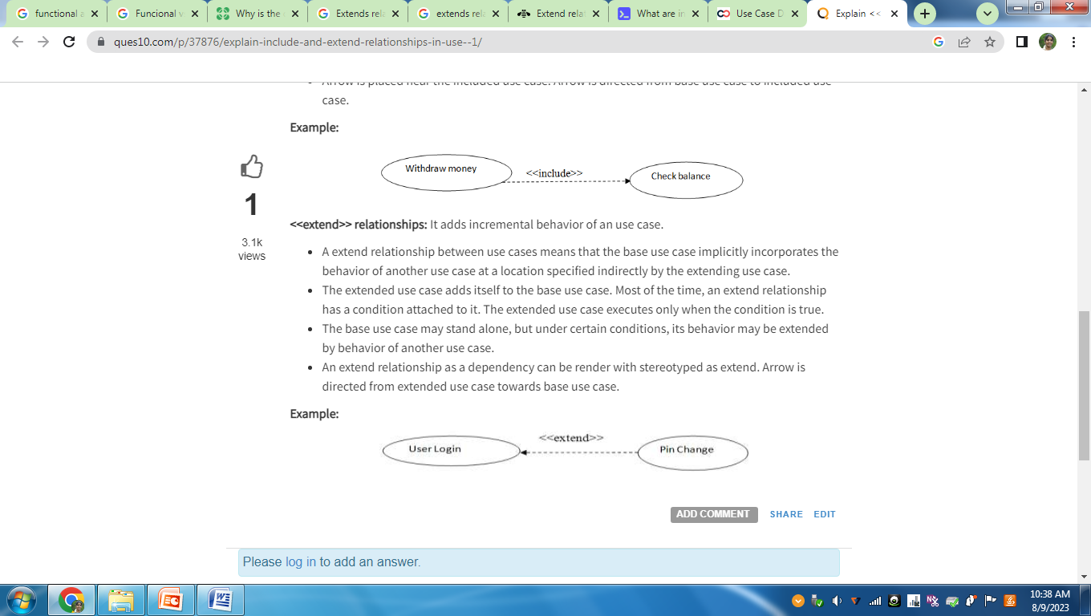
3. Requirement Elicitation and Analysis (contd..)
Relationship among use cases
2. Extends relationship
Example 1
In above diagram,
User login – Base use case
Pin change – Extension use case
Not every time when user login he may change the pin

Slide 19
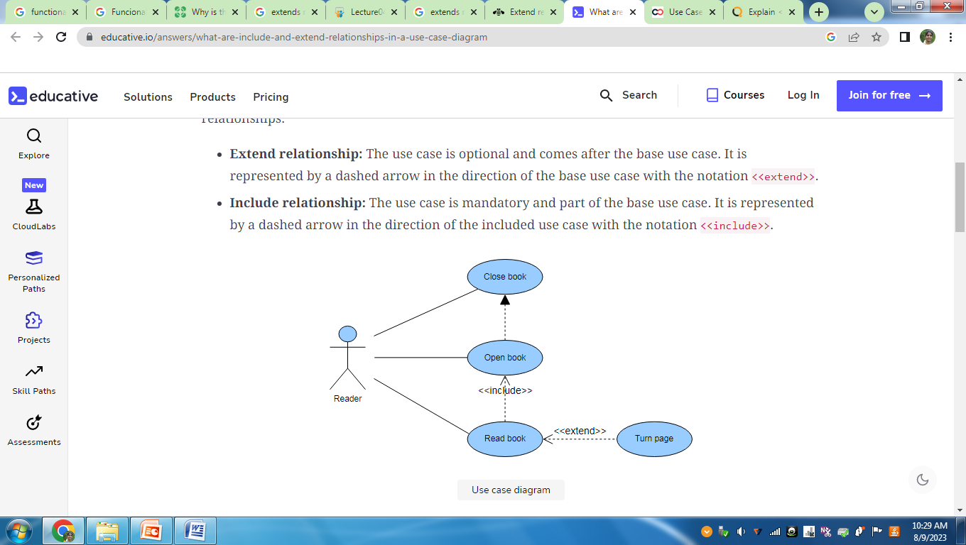
3. Requirement Elicitation and Analysis (contd..)
Relationship among use cases
2. Extends relationship
Example 2
In above diagram,
Read Book – Base use case
Turn Page – Extension use case
Not every time when user reads book he may turn the page. He may read only a single page also

Slide 20
3. Requirement Elicitation and Analysis (contd..)
Relationship among use cases
3. Include (or) Uses relationship
The use case is mandatory and part of the base use case then there is an include relationship
Include relationship show that the behavior of the included use case is part of the including (base) use case
The base use case is incomplete without the included use case.
The included use case is mandatory and not optional.
It is represented by a dashed arrow in the direction of the included use case with the notation <<include>>.

Slide 21
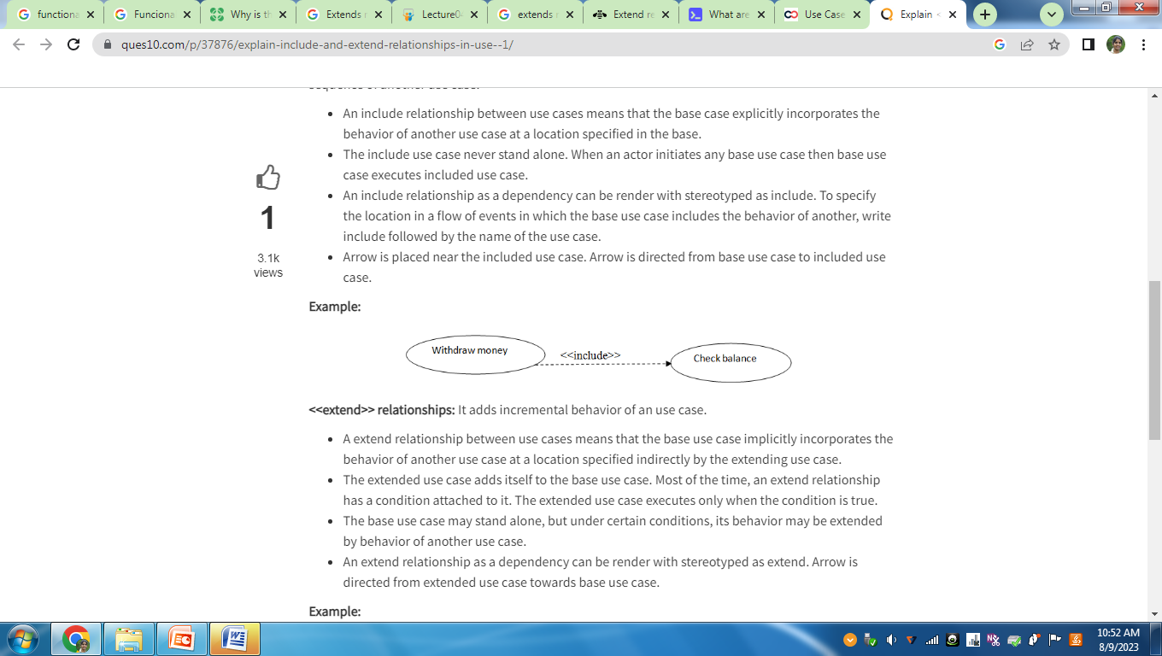
3. Requirement Elicitation and Analysis (contd..)
Relationship among use cases
3. Include relationship
Example 1
In above diagram,
Withdraw money – Base use case
Check balance– included use case
In order to withdraw money we have to check the balance then only withdraw is done

Slide 22
3. Requirement Elicitation and Analysis (contd..)
Relationship among use cases
3. Include relationship
Example 2
In above diagram,
Read Book – Base use case
Open book – Included use case
In order to read the book we have to open the book

Slide 23
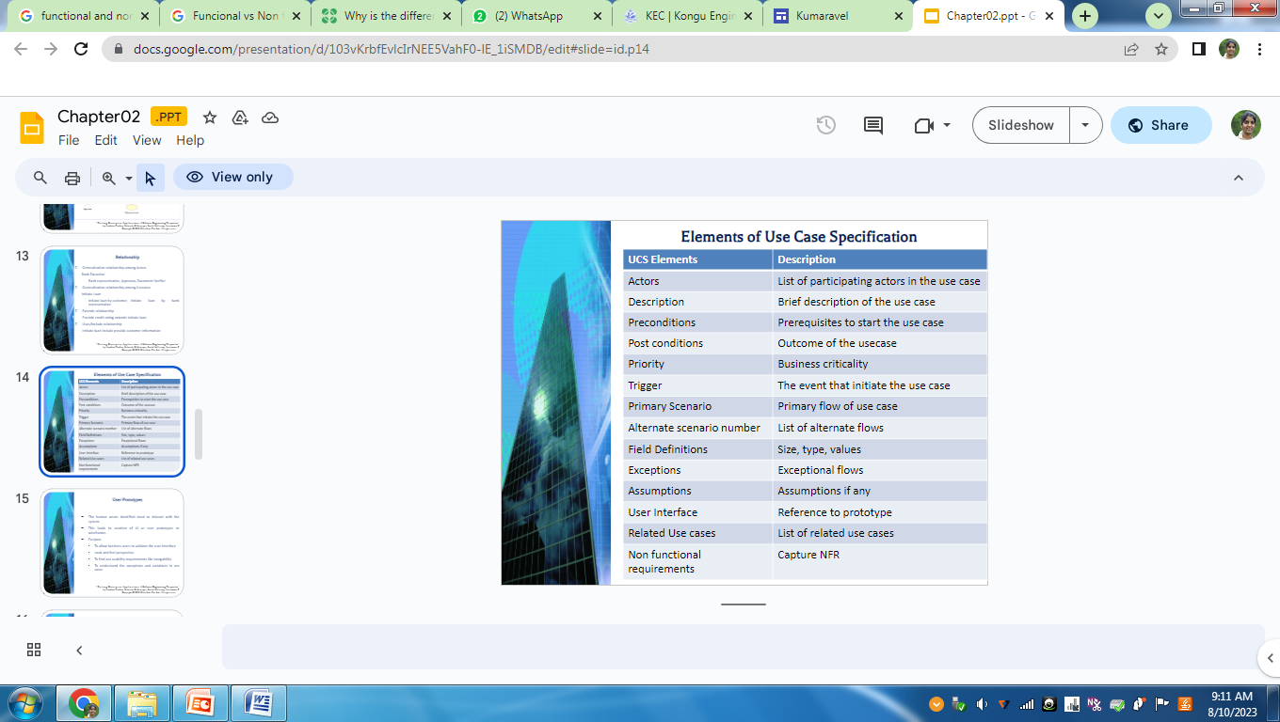
3. Requirement Elicitation and Analysis (contd..)
Use case Specification(UCS)
Use case diagram does not provide a description of use case functionality
A textual description of use case functionality is documented which is called as use case specification(UCS)
The various elements present in the UCS are:

Slide 24
3. Requirement Elicitation and Analysis (contd..)
User Prototypes
Actors identified in the use case diagram need to interact with the system
For this purpose User Interfaces(UI) are created
Prototypes (or) Wireframes are the minimum visual elements that represent the basic user interface design
Purpose of User prototypes or Wireframes:
    To allow business users to validate the user interface
    Serves as a blueprint
    To find out usability requirements like navigability
    To understand the exceptions and variations in use cases

Slide 25
3. Requirement Elicitation and Analysis (contd..)
Nonfunctional Requirements
Characteristics and constraints associated with the application is termed as Non-functional requirements
Some of the key Nonfunctional requirements are:
Performance Requirements
Usability requirements
Scalability requirements
Interface requirements
Operating requirements
Lifecycle requirements
Regulatory requirements

Slide 26
3. Requirement Elicitation and Analysis (contd..)
Performance Requirements
3 key determinants of performance of enterprise application:
1. Workload and Throughput of a system
2. The server hosting the enterprise application
3. Underlying hardware of the enterprise application
Performance requirements divided into 2 perspective
1. Business perspective
- captures requirements like transactions, types of users, their usage pattern, request arrival pattern
2.Technology perspective
- captures requirements like Operating environment details,
system and interface details

Slide 27
3. Requirement Elicitation and Analysis (contd..)
2. Usability Requirements
Usability requirements says about user experience
This requirement says about the acceptance of application by user
Some of the following can be done for easy acceptance of application by end user
1. Effective use of screen space
2. Internationalization
3. Easy navigability
4. Browser support

Slide 28
3. Requirement Elicitation and Analysis (contd..)
3. Scalability Requirements
Ability of the system to sustain its performance with growing of users and data of the application
In order to achieve scalability resources and data storage should be added
Resources are added either to the existing system itself called as Vertical scaling or separate physical systems are attached to the existing ones called as Horizontal scaling
4. Interface Requirements
This requirements capture the steps for integration of the application with other systems
Integration can be done at various levels like:
1. Integration at user interface level
2. Integration at business data level
3. Integration at business process level

Slide 29
3. Requirement Elicitation and Analysis (contd..)
5. Operating Requirements
Requirements related to Security, Maintainability and Reliability are called as Operating Requirements
Security requirements divided into 2 categories
1.Network security requirements
- network firewalls, routers and intrusion detection
system
2.Application security requirements
- AAA (Authentication, Authorization and Auditing)

Slide 30
3. Requirement Elicitation and Analysis (contd..)
6. Life Cycle Requirements
Testing , portability, reusability and installability requirements are termed as Life cycle requirements
7. Regulatory Requirements
Legal and licensing requirements related to certain categories of sensitive data

Slide 31
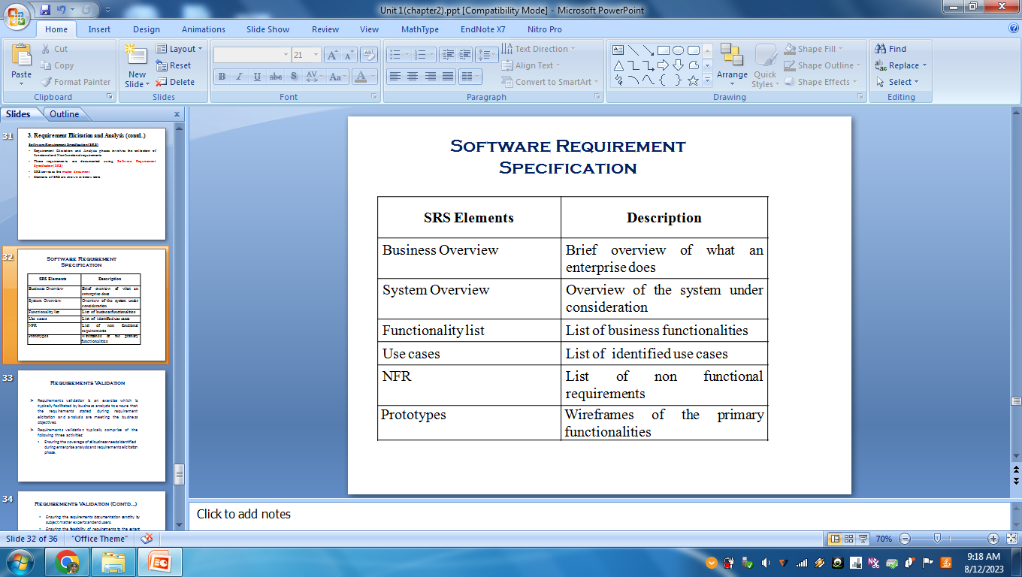
3. Requirement Elicitation and Analysis (contd..)
Software Requirement Specification(SRS)
Requirement Elicitation and Analysis phases involves the collection of functional and Nonfunctional requirements
These requirements are documented using Software Requirement Specification(SRS)
SRS serves as the master document
Elements of SRS are shown in below table

Slide 32
4. Requirement Validation
Requirements validation is an exercise which is typically facilitated by business analysts to ensure that the requirements stated during requirement elicitation and analysis are meeting the business objectives.
Requirements validation typically comprise of the following three activities:
Ensuring the coverage of all business needs identified during enterprise analysis and requirements elicitation phase.
  Ensuring the requirements documentation sanctity by subject matter experts and end users.
  Ensuring the feasibility of requirements to the extent possible.

Slide 33
4. Requirement Validation (contd..)
Techniques to perform Requirement validation like:
1. Requirements Traceability Matrix (RTM)
2. User Acceptance Test (UAT)
3. Proof of Concepts(PoC)

Slide 34
5. Planning and Estimation
Enterprise analysis leads to Business case
The business case acts as the primary input for preparing the highest level planning document called Project Charter.
Once the Project Charter is realized, detailed planning is done followed by the process of “estimation”, taking care of cost, schedule, size and effort required to build the enterprise application.
A few of the popular estimation techniques are :
  1. Ballpark Estimation: involves decisions based on heuristics. Data available in the organization from similar projects, similar domains or industry standards are used for estimation.

Slide 35
5. Planning and Estimation (contd..)
  2. Use Case Point Estimation: This estimation method depends on use case model prepared in requirement elicitation and analysis phase
  3. Function Point Estimation: A function point or FP is the unit to measure the functional size of the software under measurement. To perform FP estimation, a fully documented functional specification of the target software solution is needed.

